Slide 1
Welcoming Speech at
Cross Strait Meeting on Particle Physics and Cosmology
2011兩岸粒子物理與宇宙學研討會
歡迎詞
Da Hsuan Feng 馮達旋
Vice President, National Tsing Hua University, Hsinchu

Slide 2
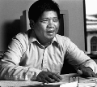
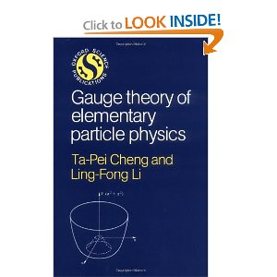
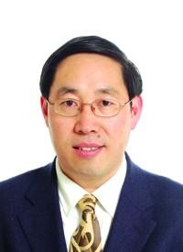
李靈峰 吴岳良

Slide 3
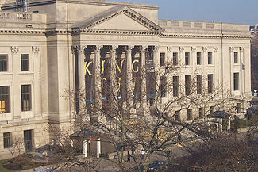
Philadelphia, Franklin Institute

Slide 4
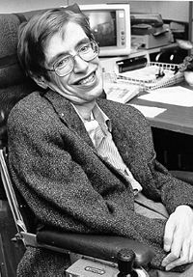
Stephen Hawking Lucasian Professor of Mathematics
In 1981, Hawking was awarded the prestigious Franklin Medal

Slide 5
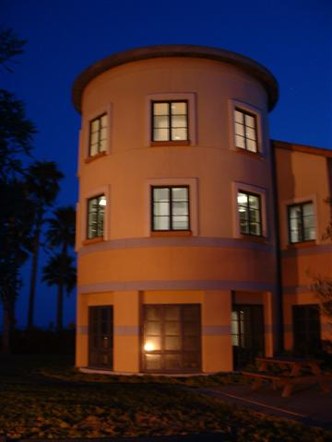
Kavli Institute of Theoretical Physics UCSB

Slide 6
馮: Professor Hawking, I am sure you do not remember me. But I was one of your hosts at the Franklin Institute last year when you received the Franklin medal.
Student on behalf of Hawking: , I remember very well that event.”

Slide 7
Student on behalf of Hawking: Professor Hawking wanted you to know that since last year, he has understood the universe!”

Slide 8
宇宙尺度的勇氣!
Cosmic Scale Courage!

Slide 9
Joking aside, ladies and gentlemen, just like Kavli Institute of Theoretical Physics on campus at UC Santa Barbara, it is important for us to realize that having a National Center of Theoretical Sciences on campus of National Tsing Hua University, which sits right next to the genesis and the heart of Taiwan’s economic miracle, Hsinchu Science Park (HSP,) has in my mind profound implications.

Slide 10
Why should the search for the ultimate building blocks and origin of the universe be pursued in Tsing Hua?

Slide 11
Thus on the surface, it is indeed a dichotomy that when research universities today, especially those with “science and technology” flavors, are embedded in “commercialization” high fever that it would also be proactively promoting such “un-commercializable” research activities.

Slide 12
The simple answer is because creativity and innovative (創新) arise from all forms of human intellectual activities.

Slide 13
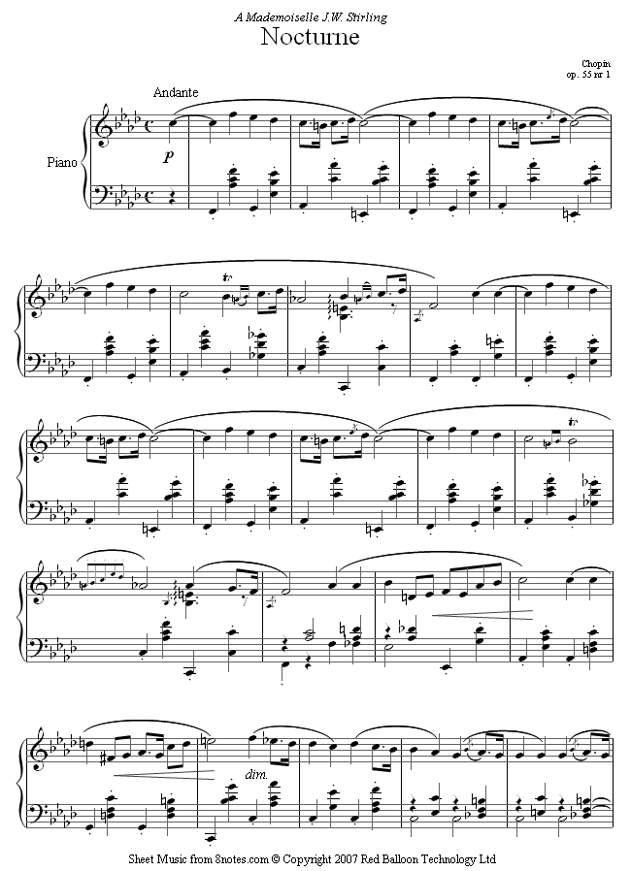
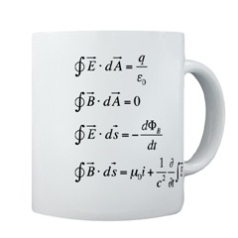
麥克斯韋方程式 蕭邦小夜曲

Slide 14
什麼是偉大的大學﹖

Slide 15
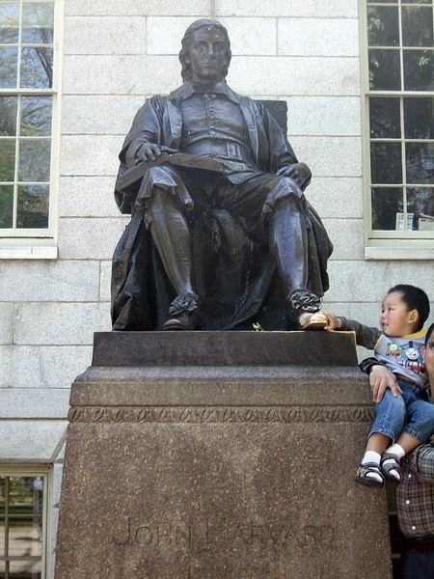

Slide 16
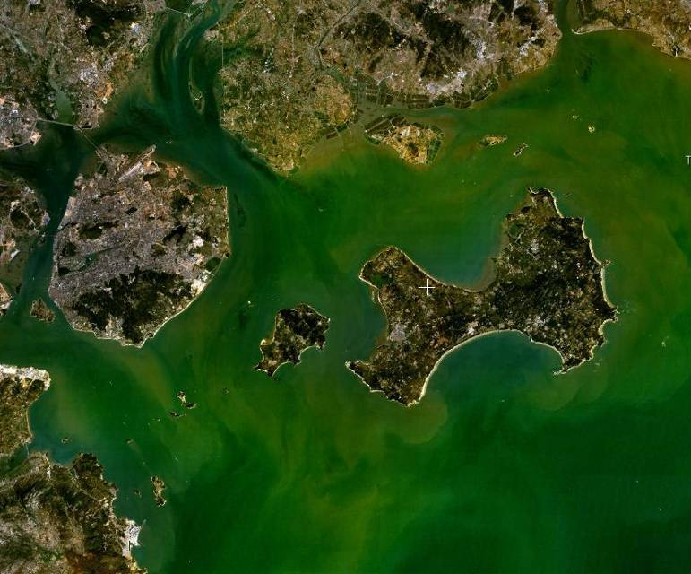
閩南文化的核心﹐也是兩岸的介子﹐是福建省邊上的一個小島叫金門!

Slide 17
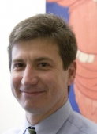
Michael Szonyi, Harvard University

Slide 18
1969年不朽的對話

Slide 19
兩院原子能委員會 Congressional Joint Committee on Atomic Energy

Slide 20
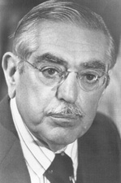
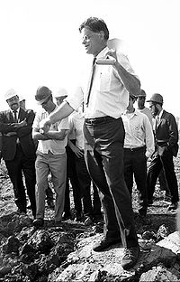
左: Senator John O. Pastore of Rhode Island
右﹕ 費米实验室主任Robert Wilson实验室 动土照片

Slide 21
Pastore: Is there anything connected in the hopes of this accelerator that in any way involves the security of this country? Wilson: No sir; I do not believe so. Pastore: Nothing at all? Wilson: Nothing at all. Pastore: It has no value in that respect?

Slide 22
Wilson: It only has to do with the respect with which we regard one another, the dignity of men, our love of culture. It has to do with those things. It has nothing to do with the military, I am sorry.
Pastore: Don't be sorry for it.
Wilson: I am not, but I cannot in honesty say it has any such application.

Slide 23
Pastore: Is there anything here that projects us in a position of being competitive with the Russians, with regard to this race? Wilson: Only from a long-range point of view, of a developing technology. Otherwise, it has to do with: Are we good painters, good sculptors, great poets? I mean all the things that we really venerate and honor in our country and are patriotic about..

Slide 24
Wilson: In that sense, this new knowledge has all to do with honor and country but it has nothing to do directly with defending our country, except to make it worth defending.

Slide 25
I believe that it is through writing poetry, pursuing Quemoyian history and culture, to unlock the ultimate building blocks of nature and the origin of the universe, as irrelevant as they may seem, along with creating a new LED, nanotechnology and graphene devices and understanding how protein degenerate through the ubiquitin agent are what humanity is all about. It is the proactive pursue of such intellectual efforts within the boundaries of a university, albeit Cambridge University or Hsinchu’s Tsing Hua University, that will make a university great.

Slide 26
謝謝﹗

